Slide 1


Advance Red Team Attacks
By Yash Bharadwaj & Satyam Dubey

Slide 2
Whoami
Advance Red Team Attacks
Yash Bharadwaj :
Security Researcher.
Deeply interested in: Red Teaming AD environment, building TTP’s, AV evasion & Windows Internals.
Future Goals: Bug Bounty, learning DevSecOps & high level research in Windows internals.
Satyam Dubey :
Security Researcher.
Interested in: Building Lab environment for simulation, performing covert operations on attack surface, evading defence mechanism in all possible vectors.
Want to engage in doing research to learn new things.
By Yash Bharadwaj & Satyam Dubey

Slide 3
Advance Red Team Attacks
Quick Introduction to workshop :
This Workshop is focused to provide a gist about red teaming, the art of mimicking the actions of threat actor on the attack surface.
Covering the basics of Red Teaming methodology in the provided environment.
Demonstration of the red team attacks on the Real World Infrastructure of a dummy organization.
Last but not the Least, providing defence tips against demonstrated attacks.
By Yash Bharadwaj & Satyam Dubey

Slide 4
Advance Red Team Attacks
Gist About Red Teaming :
Red Teaming can have multiple definitions based on how we see the things but from our perspective i.e. security perspective:
Red Team is an independent group of people who performs red teaming.
Red Teaming is the art of mimicking the nature and actions of threat actor on the attack surface to find the security potholes in the defence mechanism of the organization.
By Yash Bharadwaj & Satyam Dubey

Slide 5
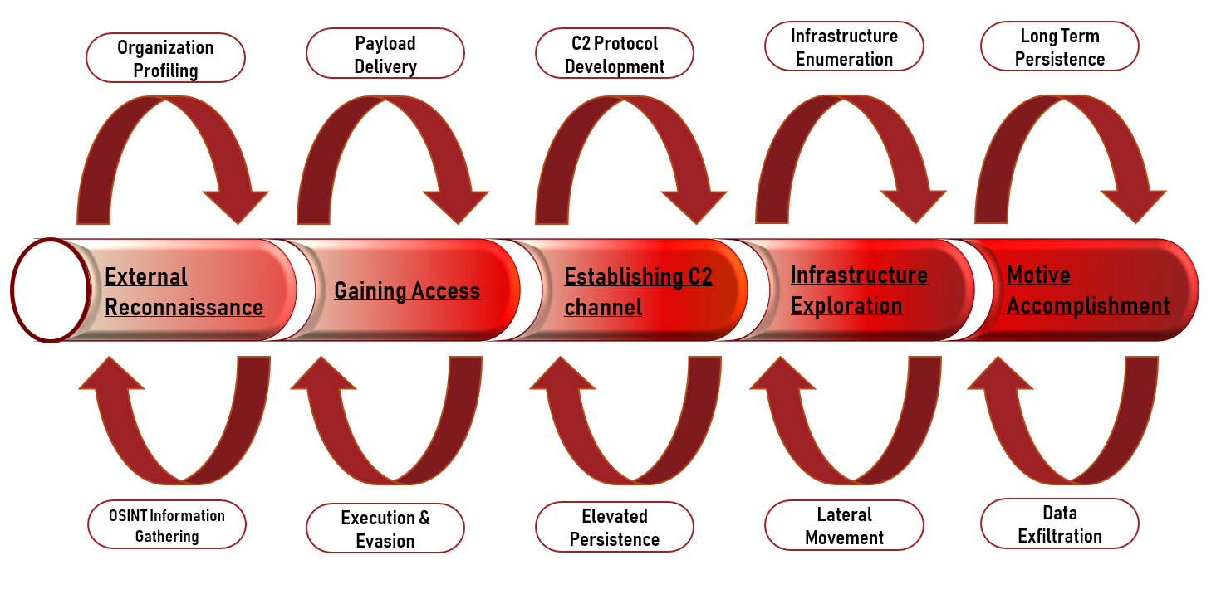
Red Teaming Methodology:
Advance Red Team Attacks
By Yash Bharadwaj & Satyam Dubey

Slide 6
Advance Red Team Attacks
About Lab Architecture :
In order to demonstrate the red team attacks, we will be using active directory based environment.
To make it more realistic a dummy infrastructure of a organization named “InfoCorpClan” is setup to simulate the red team attacks.
Motive accomplishment is the last goal of the lab which is to steal data.
As we are using active directory environment most of the attacks demonstrated will be related to the authentication protocol used which is Kerberos.
To simulate these attacks we will also be performing security control bypass.
By Yash Bharadwaj & Satyam Dubey

Slide 7

Advance Red Team Attacks
By Yash Bharadwaj & Satyam Dubey

Slide 8
Advance Red Team Attacks
Lab Architecture for the Organization
Drum rolls ……… ☺
By Yash Bharadwaj & Satyam Dubey

Slide 9
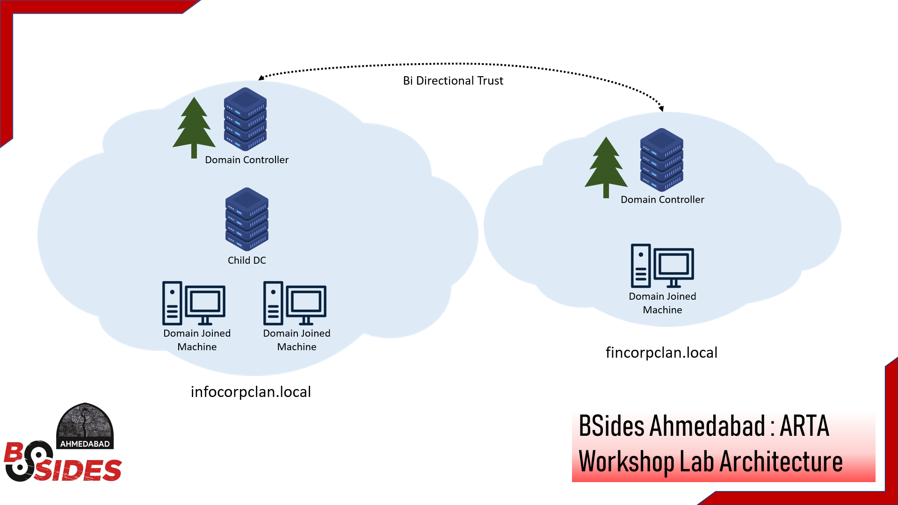
Advance Red Team Attacks
By Yash Bharadwaj & Satyam Dubey

Slide 10
Advance Red Team Attacks
Introduction to Active Directory:
Think of this as a service which enable secure & centralized management of an entire network.
It provides a solution to manage network users, services, devices & additional information that is easily accessible by users and admins.
Through AD, a network can have manageability, security & interoperability among Windows users, servers, clients, applications, network devices, firewall services & other directories.
By Yash Bharadwaj & Satyam Dubey

Slide 11
Advance Red Team Attacks
AD requires a DNS infrastructure for active operation among all the resources.
Authorization & Authentication in AD environment is done through Kerberos protocol.
Query of any object/resource available in the domain is done through LDAP (Lightweight Directory Access Protocol) which is based on TCP/IP & follows a client-server model.
Least privileges & Role-based access control can be deployed by admins to secure the AD environment.
By Yash Bharadwaj & Satyam Dubey

Slide 12
Advance Red Team Attacks
Take on Kerberos :
Kerberos is the principal protocol used for authentication and authorization in Active Directory Environment.
Kerberos protocol provides two services :
Authentication Service : issues ticket-granting tickets (TGTs) for connection to the ticket-granting service in its own domain or in any trusted domain.
Ticket Granting Service : This service issues tickets for connection to computers in its own domain.
By Yash Bharadwaj & Satyam Dubey

Slide 13
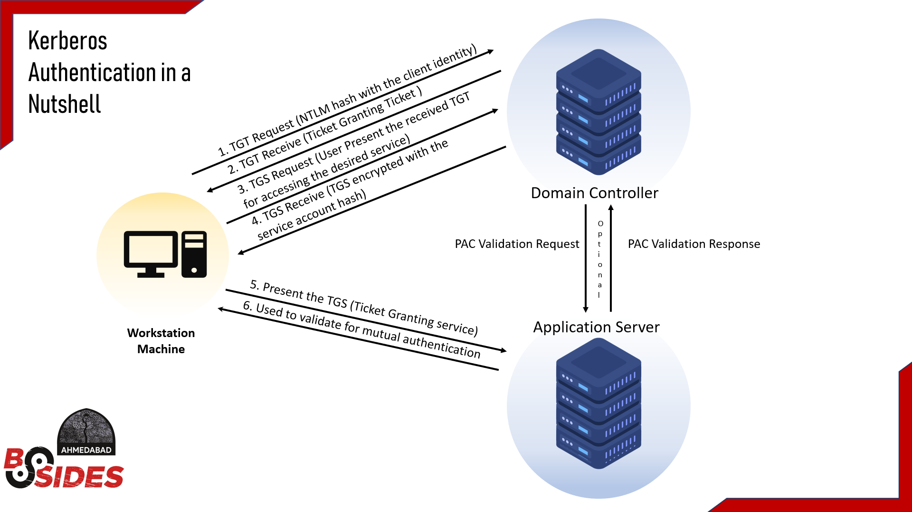
Advance Red Team Attacks
By Yash Bharadwaj & Satyam Dubey

Slide 14
Advance Red Team Attacks
Let’s Look at a Real-Life Examples that can be relatable to the working of Kerberos Protocol for authentication !
By Yash Bharadwaj & Satyam Dubey

Slide 15
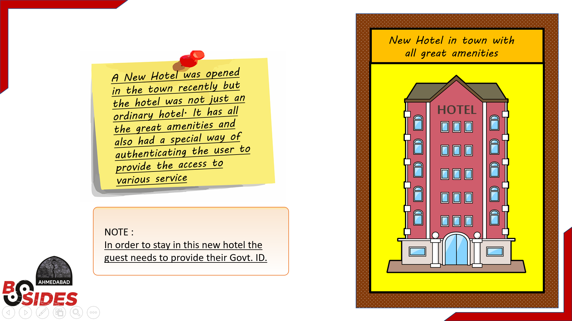
Advance Red Team Attacks
By Yash Bharadwaj & Satyam Dubey

Slide 16
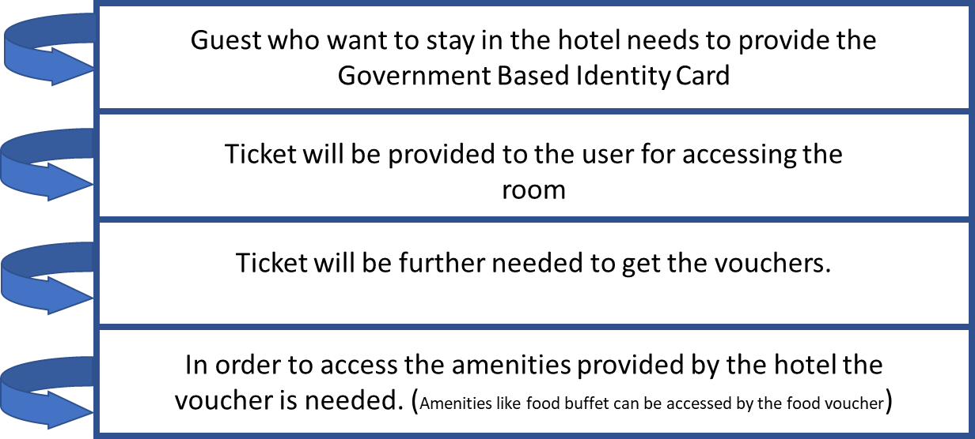
Advance Red Team Attacks
Security Authentication Principle :
By Yash Bharadwaj & Satyam Dubey

Slide 17
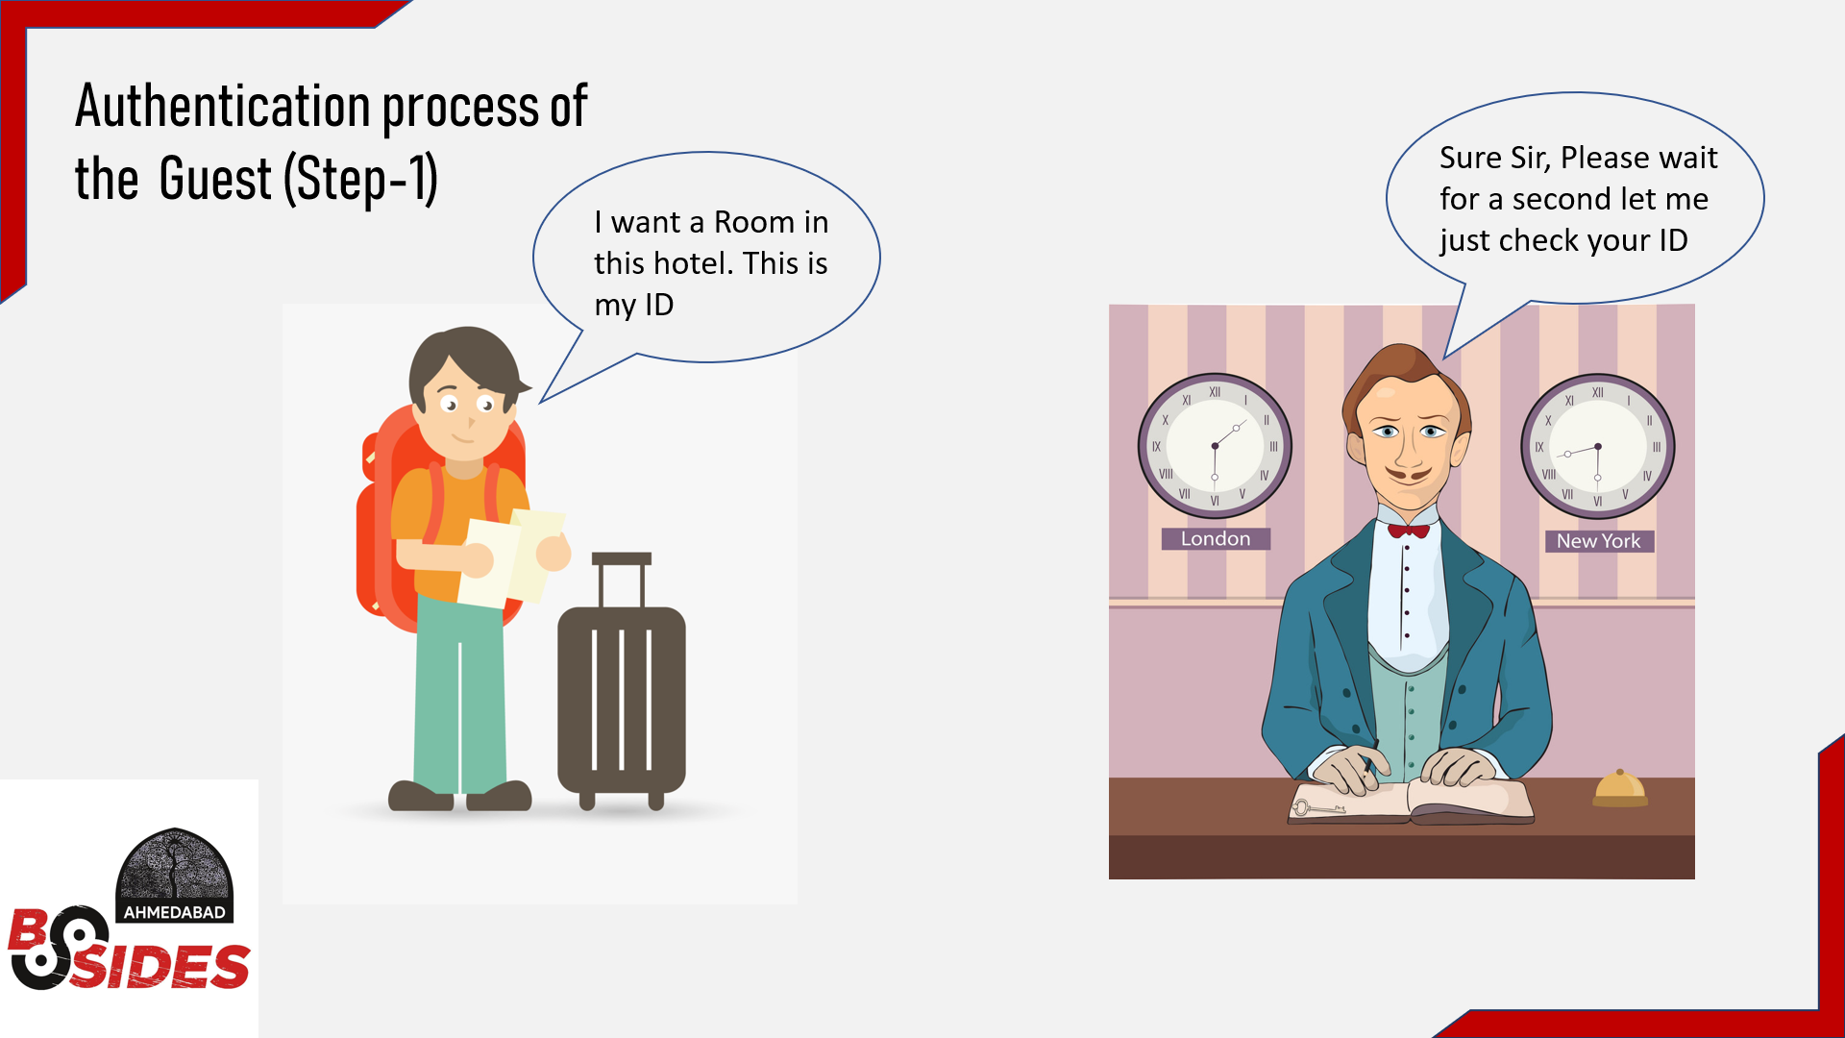
Advance Red Team Attacks
By Yash Bharadwaj & Satyam Dubey

Slide 18
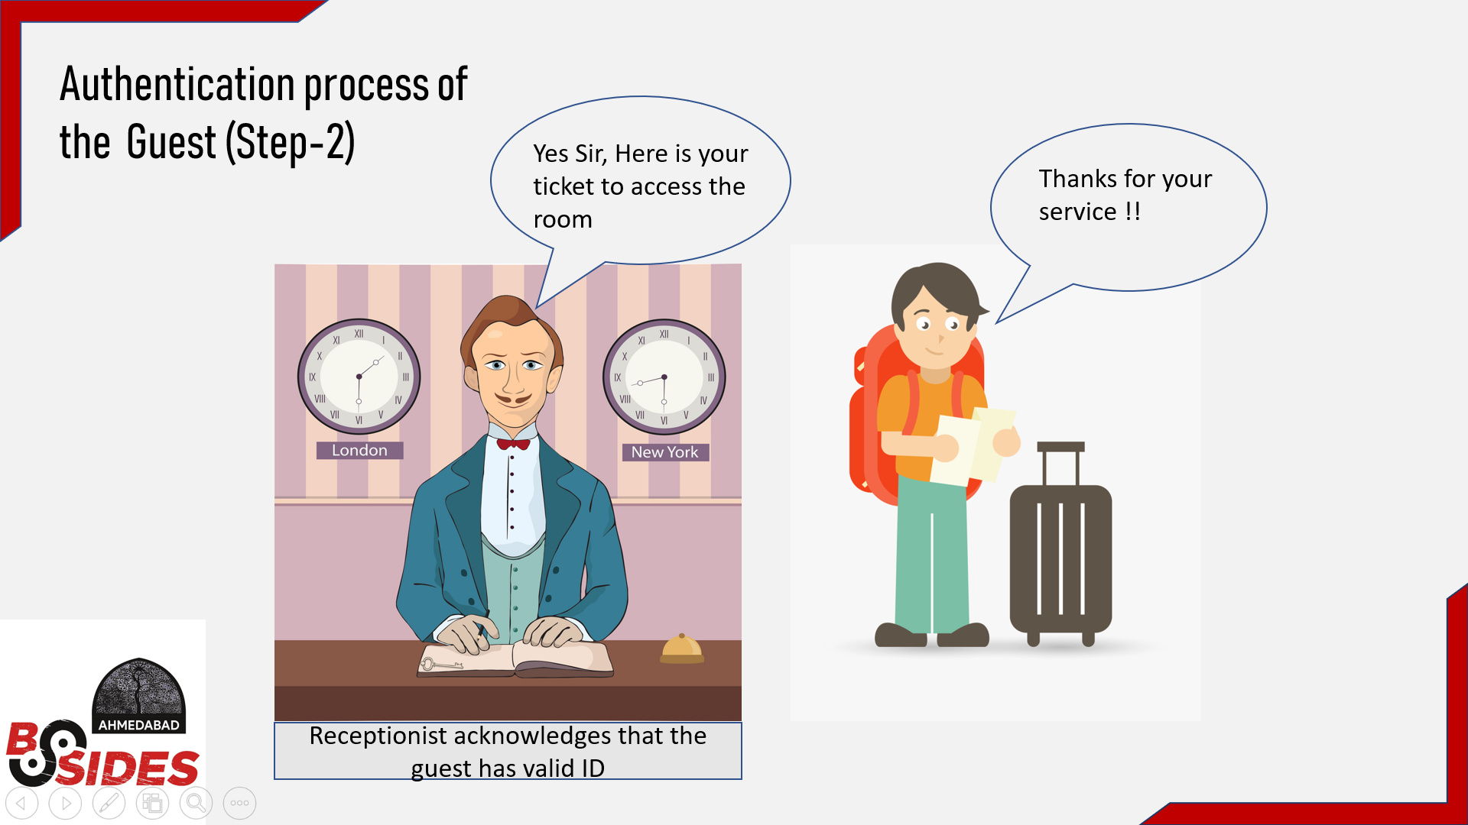
Advance Red Team Attacks
By Yash Bharadwaj & Satyam Dubey

Slide 19
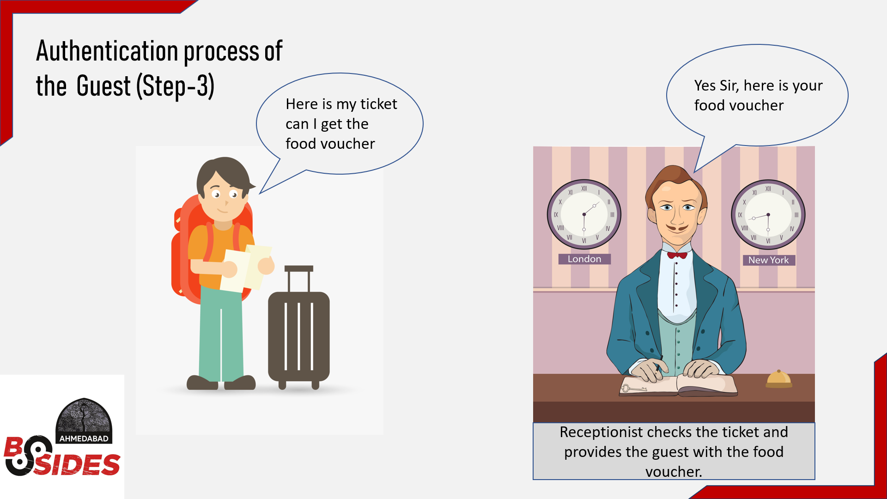
Advance Red Team Attacks
By Yash Bharadwaj & Satyam Dubey

Slide 20
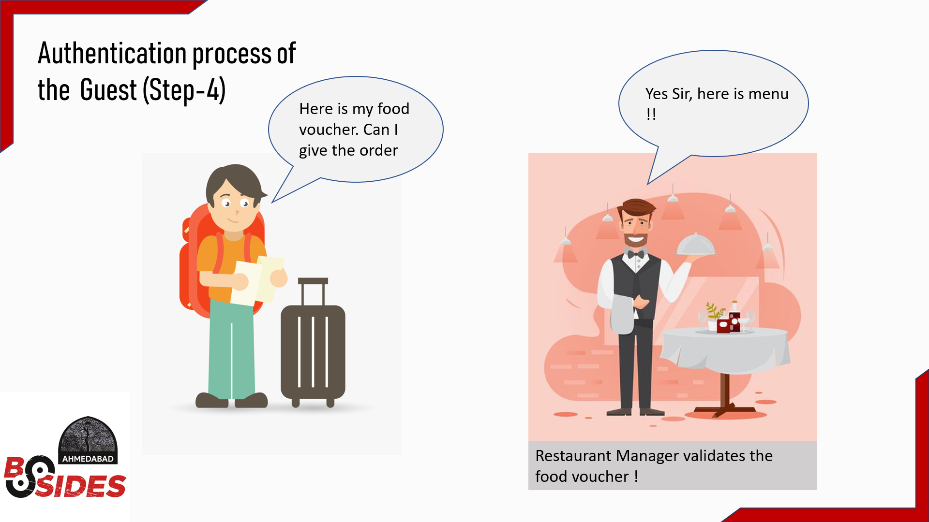
Advance Red Team Attacks
By Yash Bharadwaj & Satyam Dubey

Slide 21
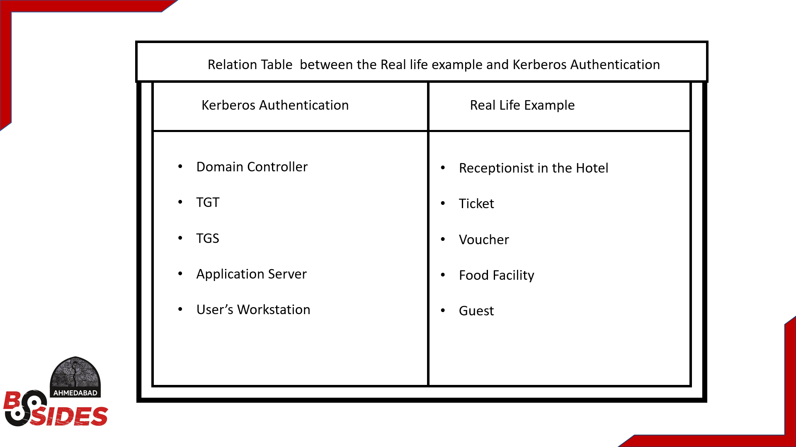
Advance Red Team Attacks
By Yash Bharadwaj & Satyam Dubey

Slide 22

Advance Red Team Attacks
Being RED : Owning the Infrastructure

Slide 23
Advance Red Team Attacks
Initial Access (Stage - 1)
By Yash Bharadwaj & Satyam Dubey

Slide 24

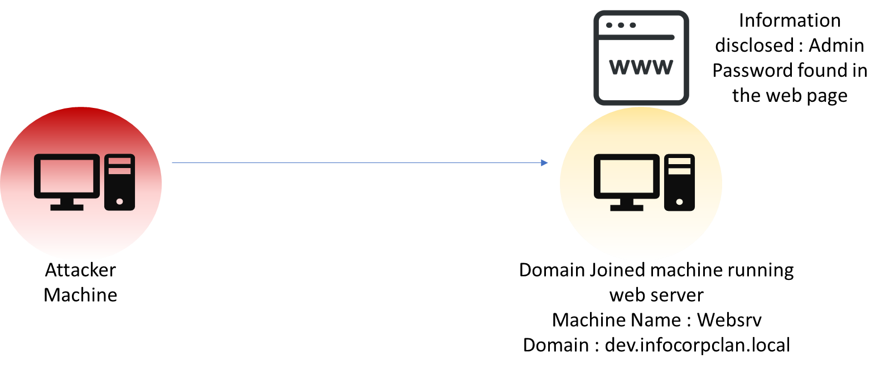
Advance Red Team Attacks
Initial Access (Stage-1):
By Yash Bharadwaj & Satyam Dubey

Slide 25
Advance Red Team Attacks
We got the initial access ☺ !!!
By Yash Bharadwaj & Satyam Dubey

Slide 26
Advance Red Team Attacks
Extensive AD Enumeration :
Enumerating the environment is the most crucial part of the process as the red teamer always try to find out misconfigurations & exploit weak trust relationships among resources.
An organized approach is to identify the following in given order: -
All available Forest & Domain
Trust relationship between forest
Identify role of a Machine
Privileged user accounts, groups
Privileges of service account & Machine account
By Yash Bharadwaj & Satyam Dubey

Slide 27
Advance Red Team Attacks
Group Policy Objects (GPO’s) & Access Control List (ACL) enumeration
Available network shares of a machine
Internal websites running in the environment
Service discovery using SPN scanning etc.
Maintaining covertness during enumeration is an art which should be covered not just by throwing tools at the target but by understanding the weakness & moving without triggering alarm.
Using in-built & legitimate tools to enumerate the environment is the best idea to keep footprint low.
By Yash Bharadwaj & Satyam Dubey

Slide 28
Advance Red Team Attacks
Tradecraft for enumeration with simultaneously remaining hidden under the radar:
PowerShell
Powerview
Microsoft’s AD module
Various in-built tools
By Yash Bharadwaj & Satyam Dubey

Slide 29
Advance Red Team Attacks
Lateral Movement :
The main motive of the attacker here is to map all the network devices and infiltrate machines in the environment.
This is a post-exploitation phase as it is a clear indicator that threat actor have established foothold in the environment.
During assessments in an AD environment, the goal is not having domain admin privileges but to access all the valuable resources across forest.
By Yash Bharadwaj & Satyam Dubey

Slide 30
Advance Red Team Attacks
The valuable assets can be compromised by lateral movement techniques like Clear-text creds, PowerShell Remoting, Pass the Hash, Pass the Ticket etc.
WannaCry & NotPetya are some of the best example of attacks utilizing 0-day lateral movement techniques for spreading.
Patterns are that attackers are using LOLBAS [Living of the Land Binaries & scripts] to remain under the radar.
By Yash Bharadwaj & Satyam Dubey

Slide 31
Advance Red Team Attacks
Identifying the Weak Link (Stage-2)
By Yash Bharadwaj & Satyam Dubey

Slide 32
Advance Red Team Attacks
Kerberoasting in a nutshell
By Yash Bharadwaj & Satyam Dubey

Slide 33
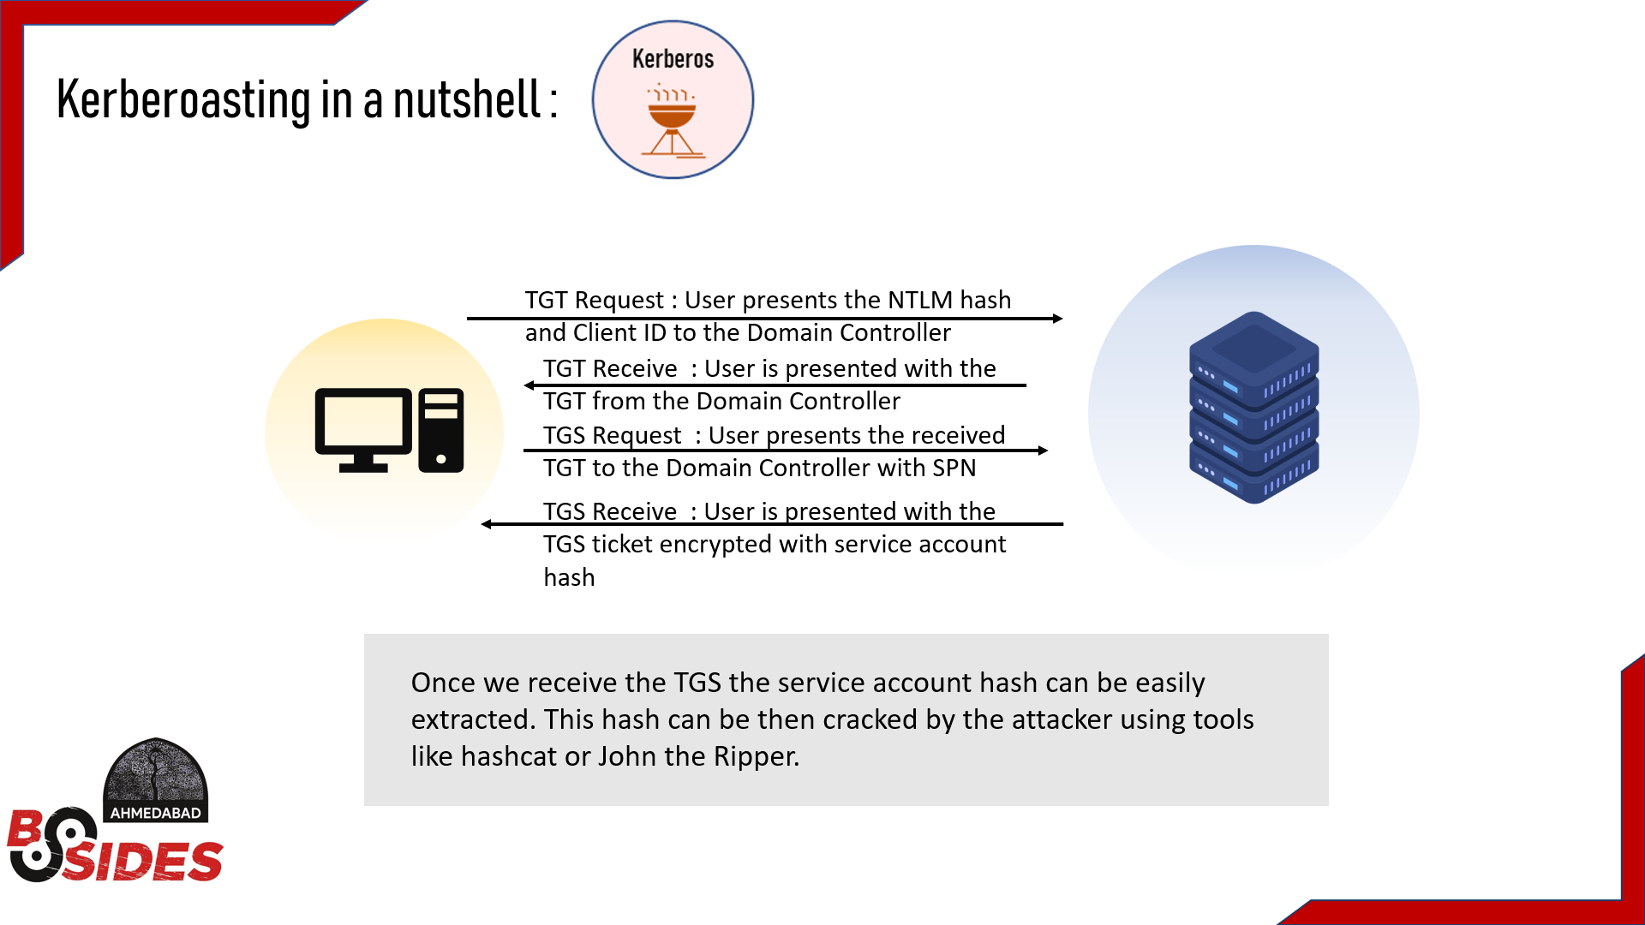
Advance Red Team Attacks
By Yash Bharadwaj & Satyam Dubey

Slide 34
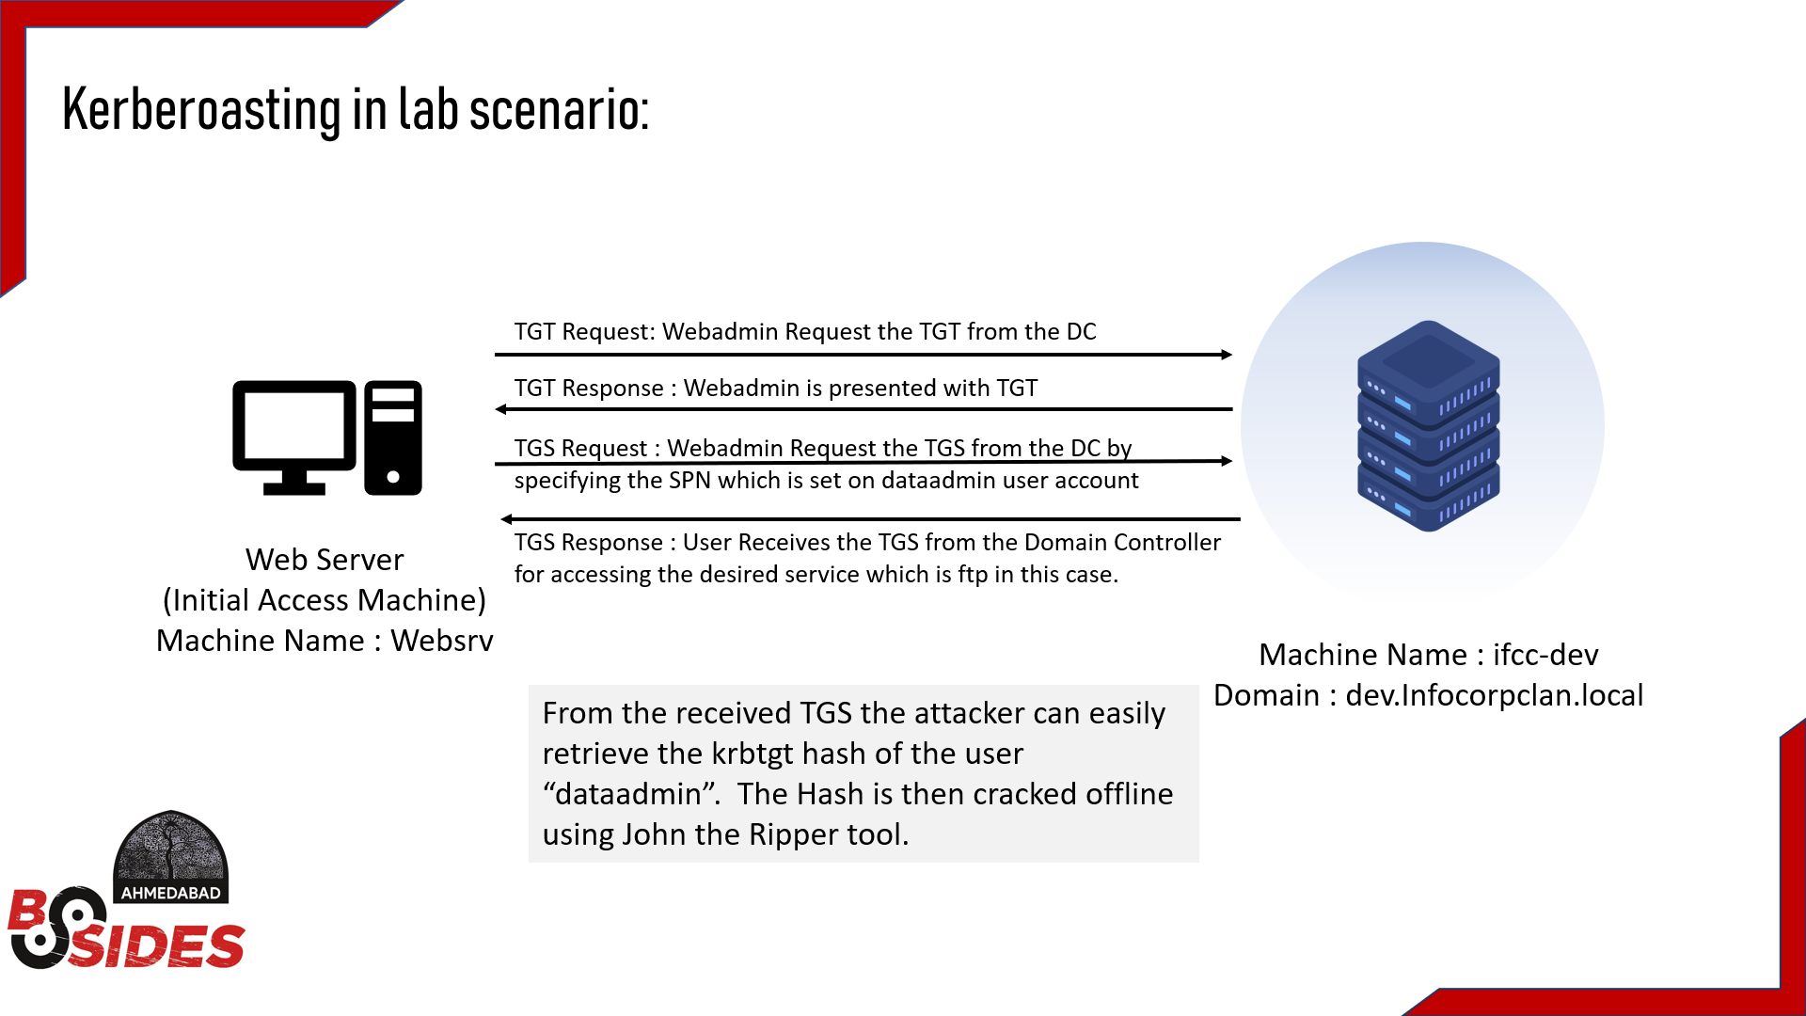
Advance Red Team Attacks
By Yash Bharadwaj & Satyam Dubey

Slide 35
Advance Red Team Attacks
Golden Ticket (Stage -3)
By Yash Bharadwaj & Satyam Dubey

Slide 36
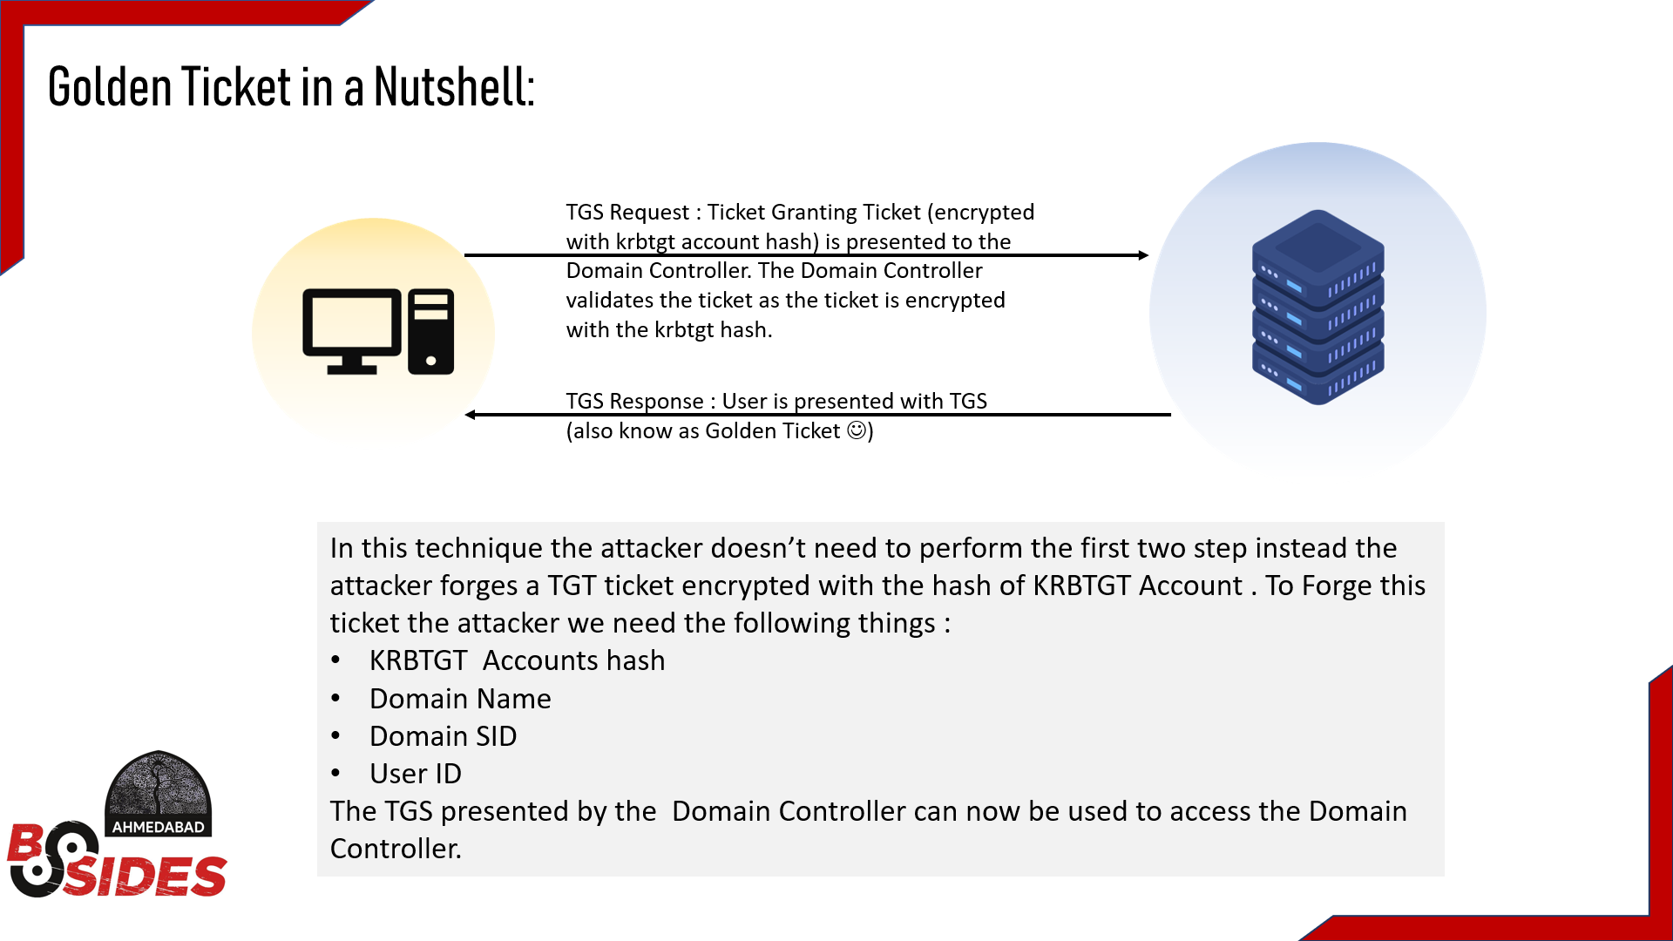
Advance Red Team Attacks
By Yash Bharadwaj & Satyam Dubey

Slide 37
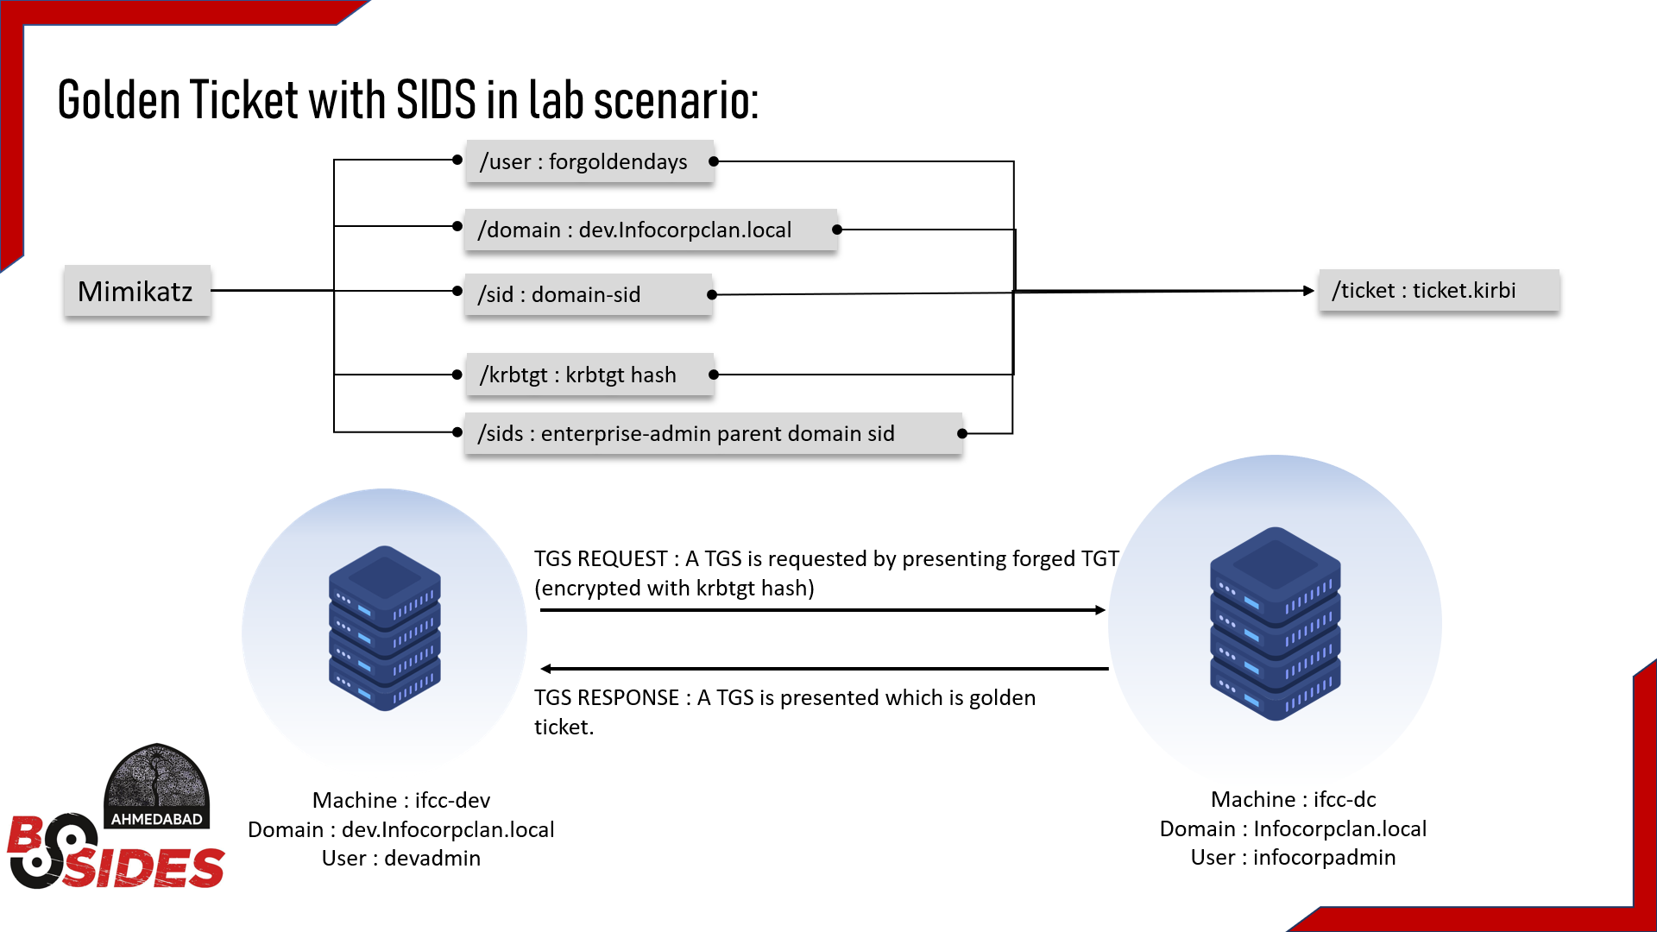
Advance Red Team Attacks
By Yash Bharadwaj & Satyam Dubey

Slide 38
Advance Red Team Attacks
Abusing the DCSync Rights (Stage -4)
By Yash Bharadwaj & Satyam Dubey

Slide 39
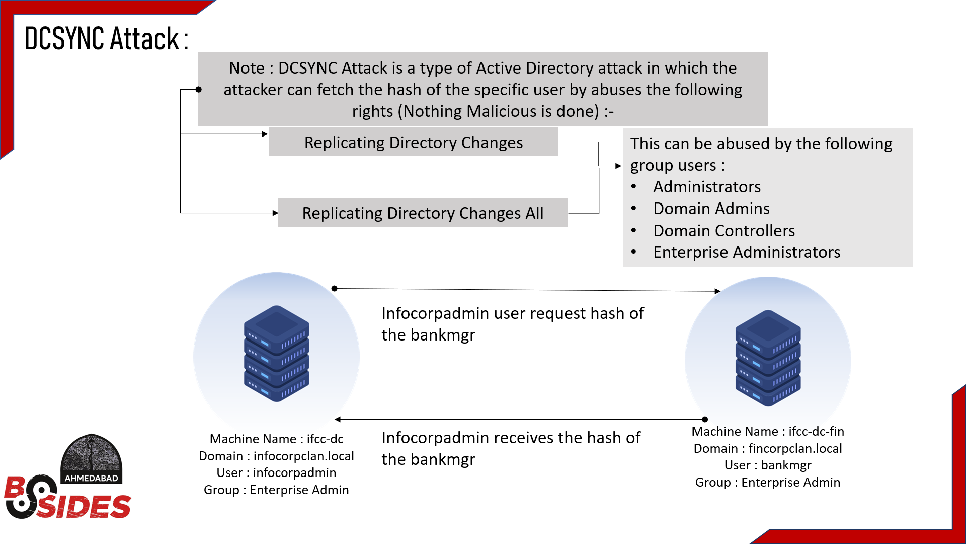
Advance Red Team Attacks
By Yash Bharadwaj & Satyam Dubey

Slide 40
Advance Red Team Attacks
EXFLITRATING CRUCIAL DATA USING L0LBINS (STAGE-5)
By Yash Bharadwaj & Satyam Dubey

Slide 41
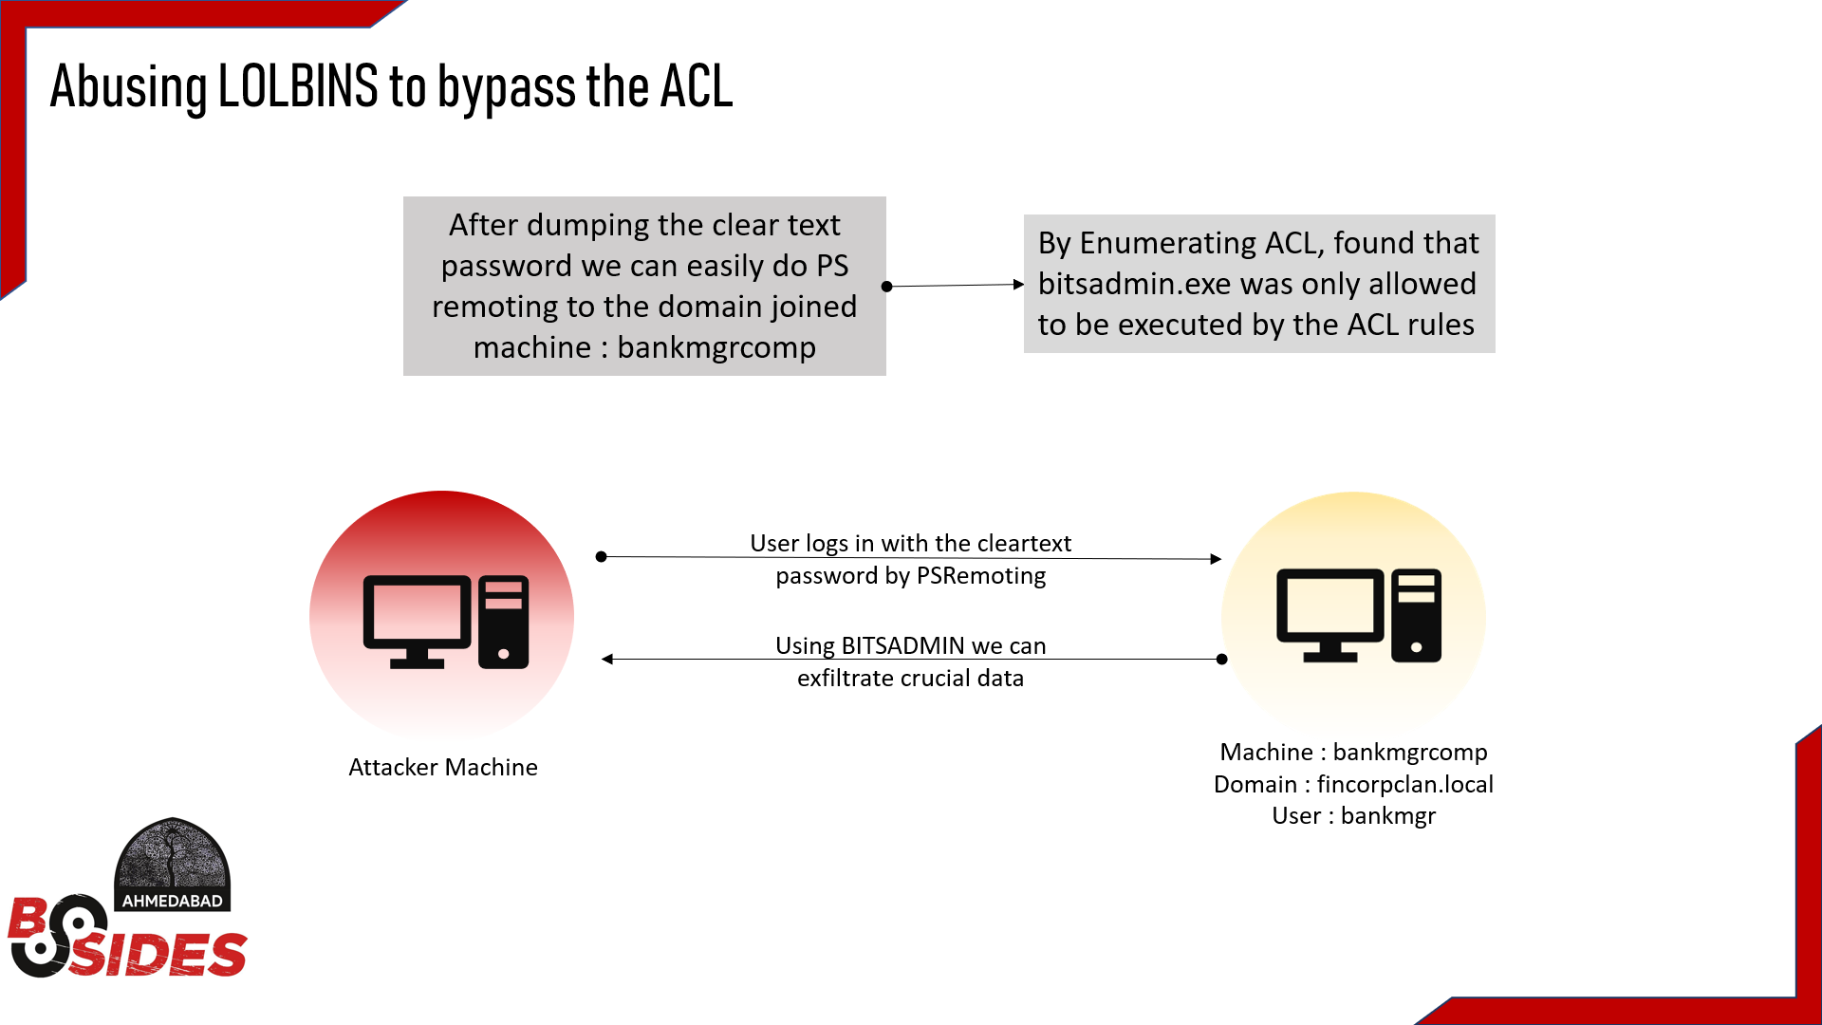
Advance Red Team Attacks
By Yash Bharadwaj & Satyam Dubey

Slide 42
Advance Red Team Attacks
MITIGATIONS
By Yash Bharadwaj & Satyam Dubey

Slide 43
Advance Red Team Attacks
MITIGATIONS:
Usage of group managed service accounts should be preferred which sets the random, complex passwords (>100 characters) and are managed automatically by Active Directory.
Password for the privileged accounts should be changed regularly.
Restrict the Domain Admins access to any other machines than Domain Controller.
Changing the built-in KRBTGT account password twice will invalidate any existing golden tickets that have been created with the KRBTGT hash and other Kerberos tickets derived from it.
By Yash Bharadwaj & Satyam Dubey

Slide 44
Advance Red Team Attacks
DEFENSE AGAINST THE ATTACKS
By Yash Bharadwaj & Satyam Dubey

Slide 45
Advance Red Team Attacks
DEFENSE:
To defend against reconnaissance : Abnormal LDAP queries should be monitored.
Active Directory administrative tier model should be adopted.
Limiting the number of users to log onto the Domain Controller.
Deployment of EDR (Endpoint Detection Response) like Microsoft Defender Advanced Threat Protection (ATP) should be considered.
By Yash Bharadwaj & Satyam Dubey

Slide 46
Advance Red Team Attacks
Thank you for your listening to us patiently ☺ !!
By Yash Bharadwaj & Satyam Dubey

Slide 47
Advance Red Team Attacks
Questions can be posted on sli.do . We will surely try to answer your questions (Event ID : #ARTA )
By Yash Bharadwaj & Satyam Dubey

